Slide 1
Motorcycle Accident Detection Application for Android Smartphones
Carl Patrick Agbisit
Rafael Bacus
Notes:
Rationale of the Study
Statement of the Problem
Significance of the Study
Scope & Limitation
C

Slide 2
Rationale of the Study
Increased percentage of motorcycle accidents from 51% (2Q 2012) to 59% (1Q 2013)
54% of total people involved in vehicular accidents are ages 20 to 44
Ages 25 to 34 have highest smartphone penetration at 81%
Smartphones becoming increasingly sophisticated
Android OS, leading mobile operating system (53%)
Utilizing sensor capabilities of smartphone & open-source Android OS to develop accident detection application.
Primary concern is to notify immediate contacts of person involved in accident
Notes:
R

Slide 3
Statement of the Problem
This study has aimed to design an application on smartphones using the Android operating system as a post-vehicular accident detection system.
The specific objectives of this research were to:
Determine the different scenarios of motorcycle accidents
Implement existing algorithms to detect changes in forces applied to the smartphone and its orientation
Develop motorcycle accident detection application
Test and Evaluate application
Notes:
C

Slide 4
Significance of the Study
This research will benefit:
Motorcyclists - Deliver messages even if unconscious or seriously injured
Youth Demographic – Majority of motorcycle accidents occur with people mid- 20s to early 30s; most smartphone users around the same age
Close Relations – Family and friends not “left in the dark”
Computing Field – Base application made available for future improvements
Notes:
R

Slide 5
Scope and Limitation
Scope
Android Operating System
Motorcyclists
GPS
Data Plan
Limitation
Older Android OS Versions (Before v4.0 “Ice Cream Sandwich”)
Smartphone rendered incapable of use during impact
No motorcycle testing

Slide 6
Test Environment
Notes:
C

Slide 7
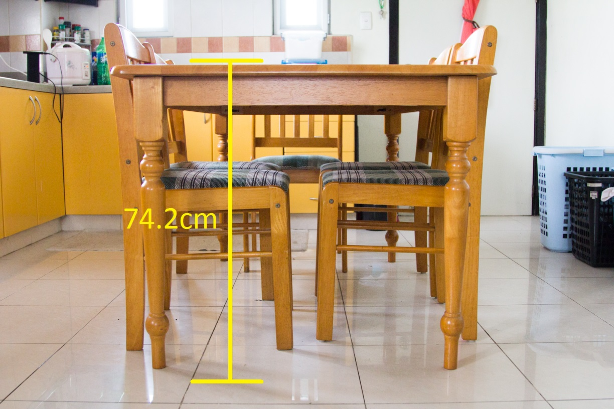
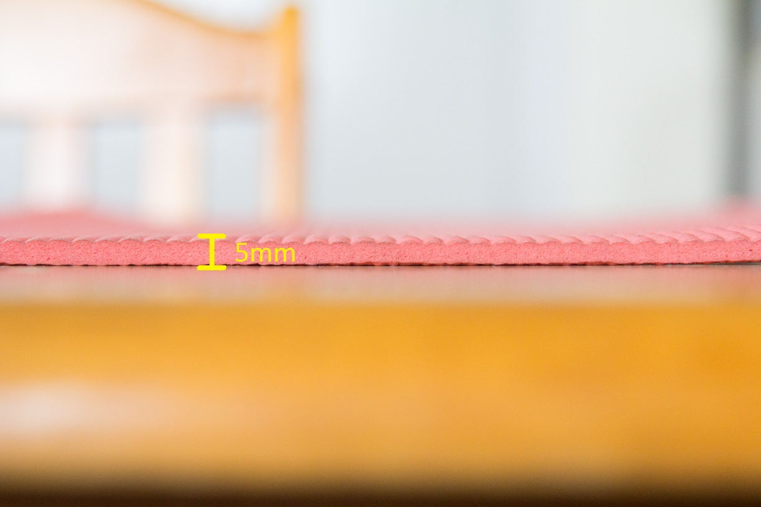
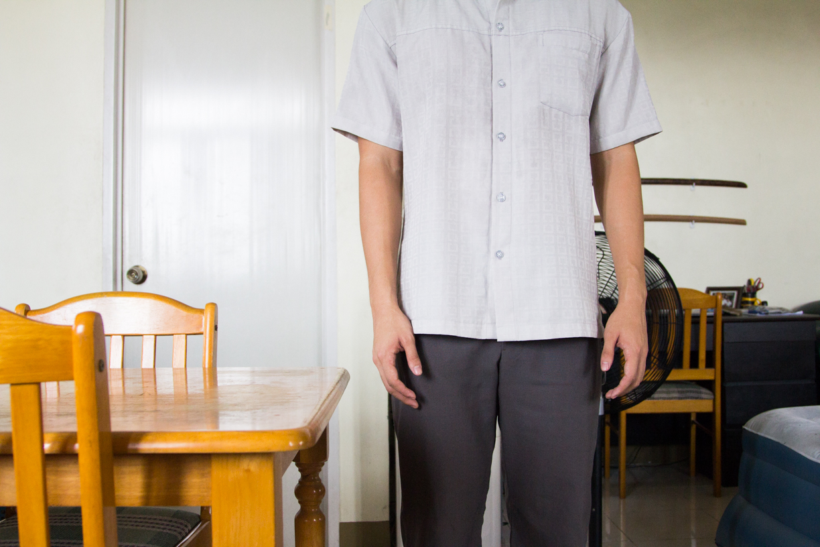
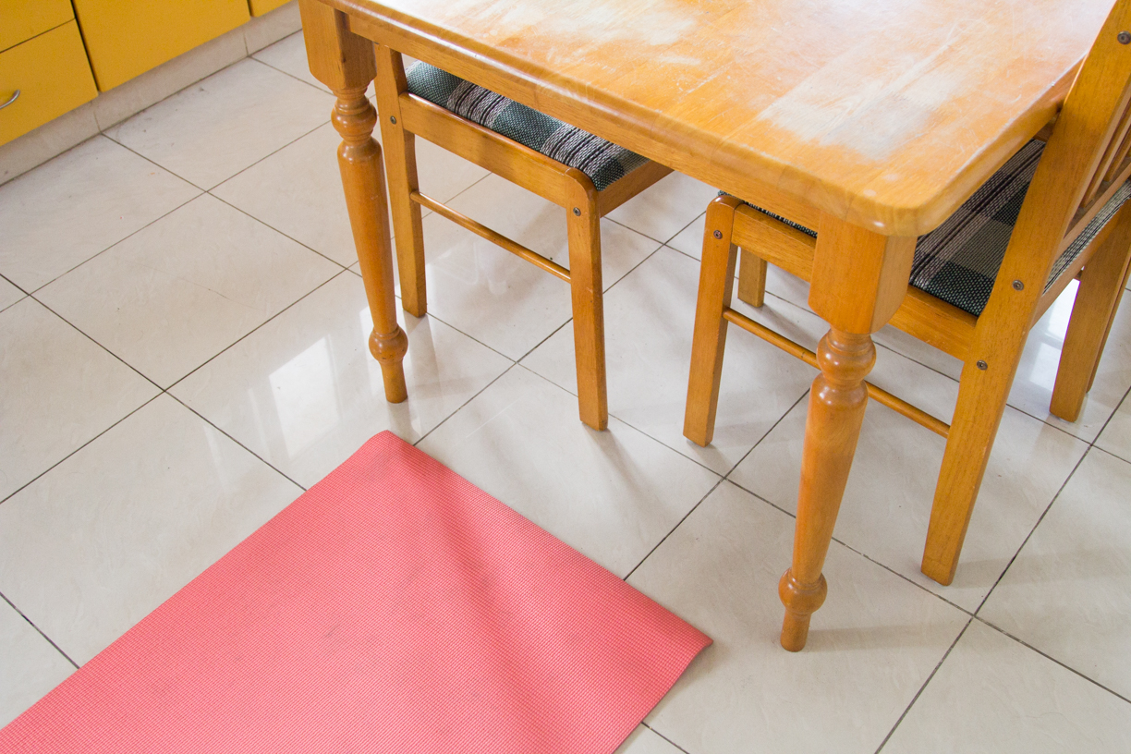
Area
Notes:
R

Slide 8
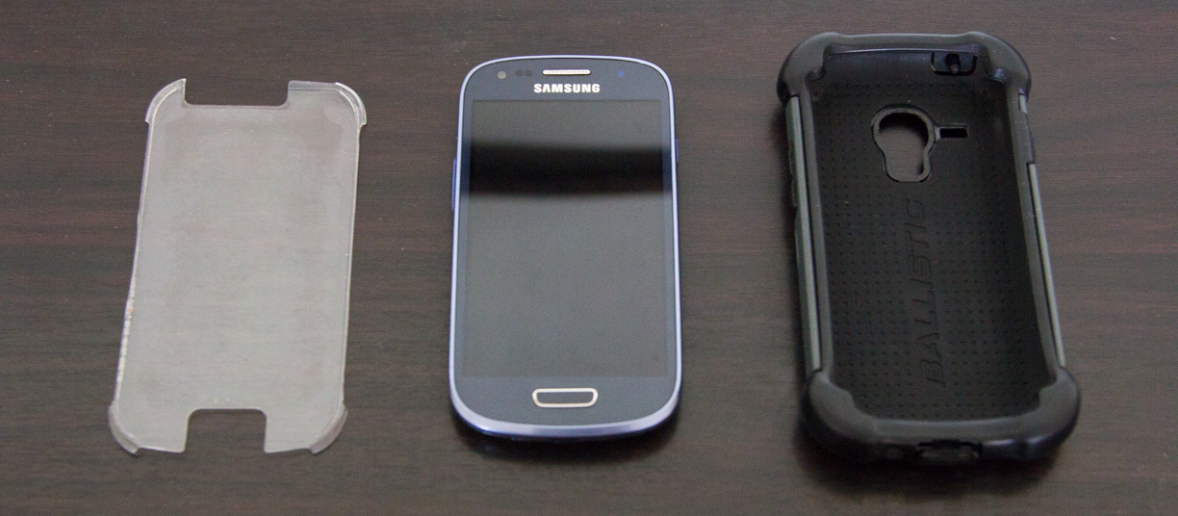
Samsung Galaxy S3 Mini SM-G370A Ballistic Hard Case
Notes:
C

Slide 9
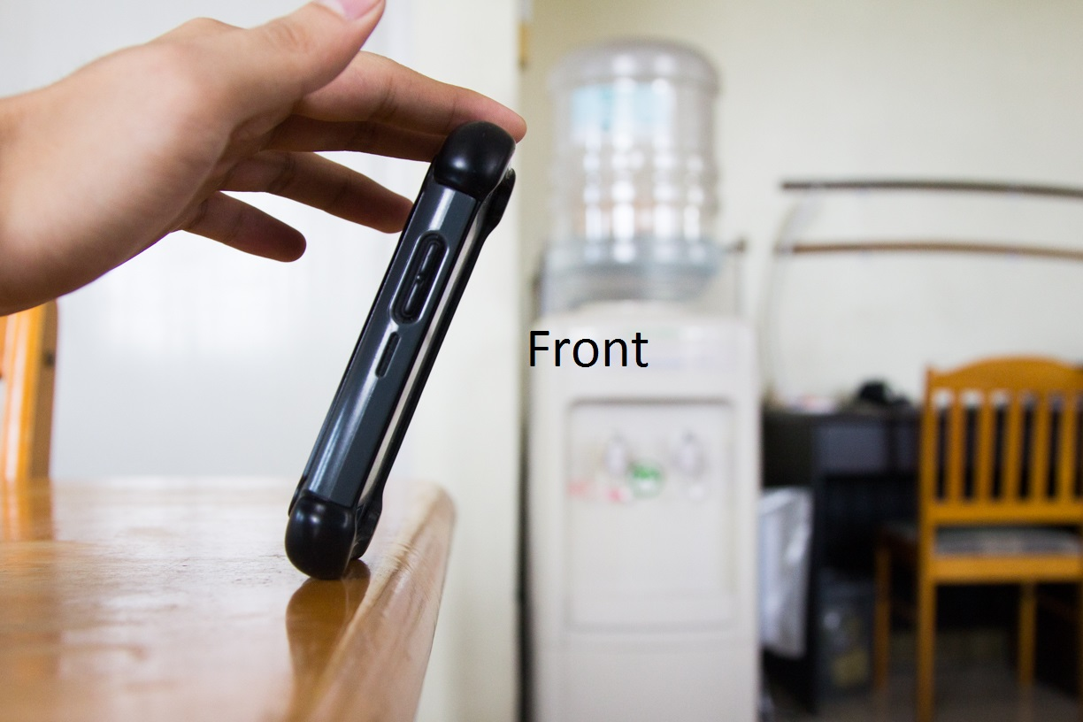
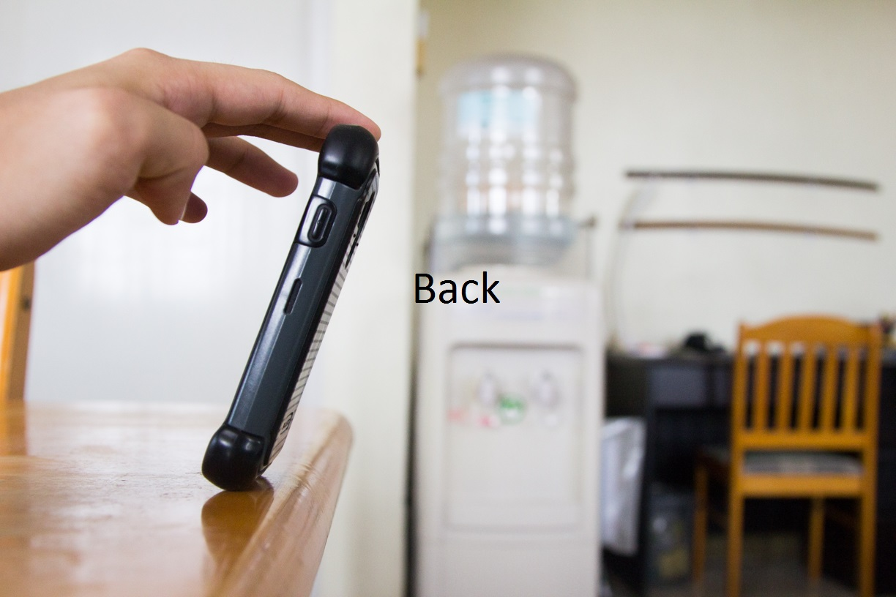
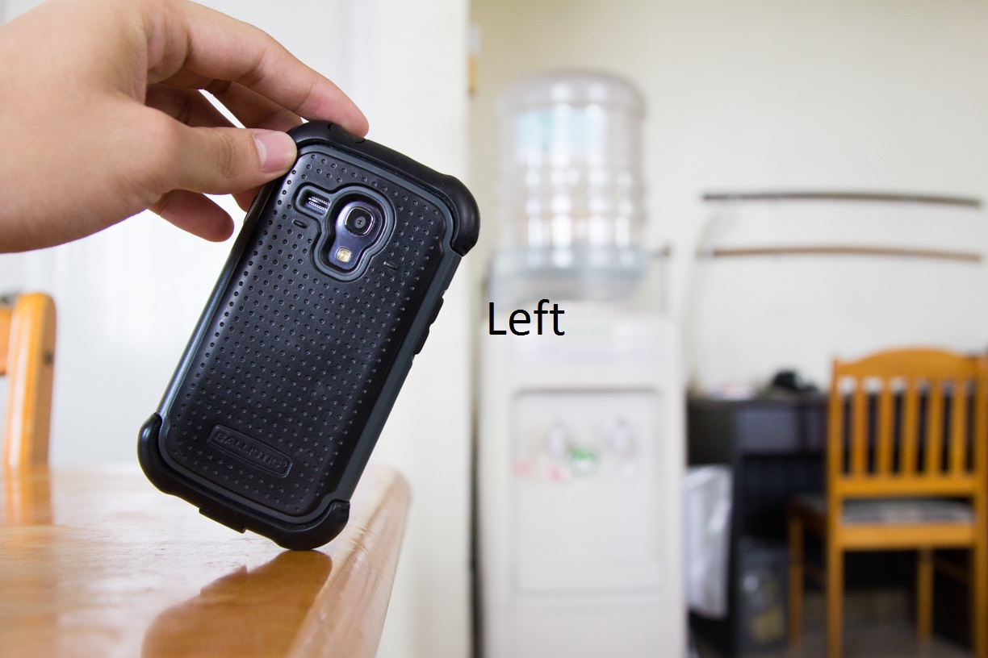
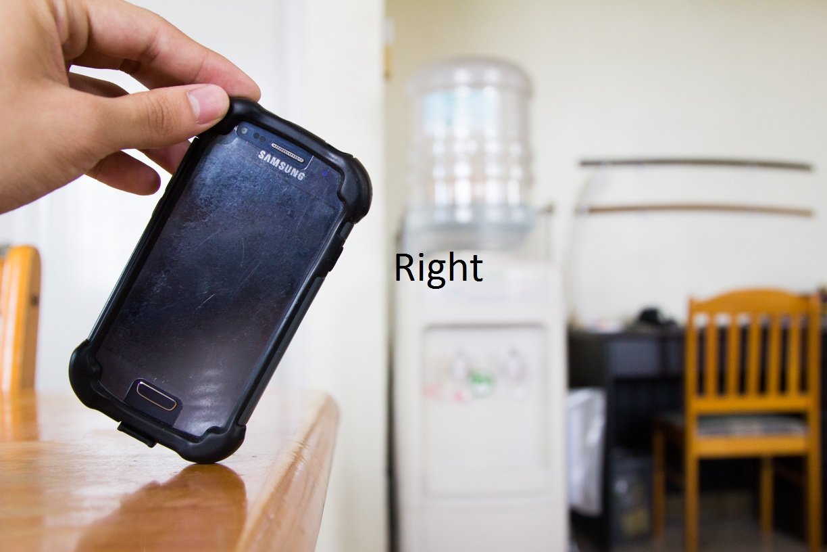
4 Orientations
Front
Back
Left
Right
5 trials each
Notes:
R

Slide 10
Online Survey
Online Survey aimed to determine the response and need for the application
15 Questions
49 Respondents
Google Forms

Slide 11
Objectives & Results
Notes:
C

Slide 12
Determine the different scenarios of motorcycle accidents
The Royal Society for the Prevention of Accidents (RoSPA)
MotorcycleAccident.org
RidersPlus
RideApart
Bends, junctions, overtaking, and loss of control
Motorcycle drives straight through intersection as vehicle makes left turn on opposite side of intersection
Entering curve at too high speeds
Road conditions unsafe
Rear-ending & cars overtaking motorcycle
Notes:
Objective 1
1. None
2. Fail to see narrow profile of motorcycle
Motorcycle going at top speeds
3. Motorcycle less maneuverable
4. Rain, leaves, gravel
5. None

Slide 13
Implement existing algorithms to detect changes in forces applied to the smartphone and its orientation
Kangas et al. threshold algorithm
Detect if device is falling
Built-in tri-axial accelerometer
Calculate sum vector using values from each axis
Calculate if impact has occurred
If sudden spike in sum vector calculations
Detect change in posture or orientation of object
Built-in gyroscope
Notes:
Objective 2
“Implementation and pseudocode will be discussed during the next objective”

Slide 14

Develop motorcycle accident detection application
LifeCycle
Notes:
Objective 3

Slide 15
LifeCycle
Eclipse Juno & Luna
Target Minimum Android 4.0
Samsung Galaxy S3 Mini
Android 4.2.2
Tri-axial Accelerometer
Gyroscope
GPS Capabilities
User Data Storage
Monitoring
Location Tracking
Messaging
Notes:
“We will briefly discuss each of the four modules and show pseudocode samples”
C

Slide 16

User Data Storage
Personal and medical information
Name
Blood type*
Age
Height
Weight
Medications
Conditions
Allergies
Shared Preferences
Emergency contacts
Name
Number
Personal message
SQLite Database
Notes:
Blood type – required
Medications, Conditions, Allergies default to “None”
Number defaults to “Select a number”
Personal Message defaults to generic message
PERSISTENT

Slide 17
class ContactsMenu{
onCreate(){
Populate emergency contact list
}
openPhonebook(){
If(numOfContacts < 10){
Redirect to device’s phonebook
User selects contact
Contact stored in SQLite DB
Default values:
Name, “Select a number”, generic message
} else{
Prompt max numOfContacts reached
}
}
getContactsFromDatabase(){
Create connection to SQLite DB
Create List<Contact>
Populate List with SQLite DB rows
Return List<Contact>
}
ifDuplicate(){
Checks if contact with same name exists in List<Contact>
}
isQualifiedNumber(){
Checks if length is 11 digits and contains no characters
}
onBackPressed(){
Check if(any contact still has “Select a number” set for Number field){
Prompts user to select a valid phone number for contact
} else{
Return to Main Menu
}
}
onListItemClick(){
If(Delete toggle is false){
Views contact details
} else{
Prompts to delete contact
}
}
}
Notes:
R

Slide 18

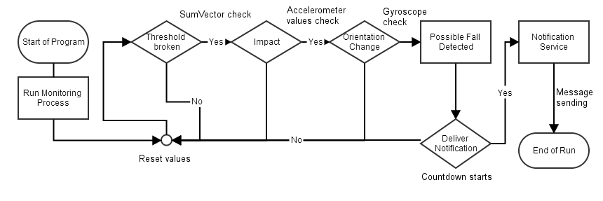
Monitoring

Slide 19
class Monitor{
onInstantiation(){
Initialize field members;
Create Dialog to display “Accident detected!”;
}
startMonitoring(){
Reset field members to default;
Start accelerometer;
}
pauseMonitoring(){
Stop accelerometer;
}
checkIfImpact(){
Check if accelerometer data has a spike in values;
}
countDown(){
Start location tracking;
Start alarm;
Start countdown timer;
}
onSensorChanged(){
Determine if accelerometer or gyroscope data;
If(accelerometer data){
Compute sum vector;
If(sum vector is 0.6 g or below){
Monitor for additional 1.2 seconds
Check if impact occurred during additional 1.2 seconds
If(impact & rotation occurred){
Display “Accident detected!” dialog
Start countdown timer to send messages
} else{
Reset class field members;
}
}
} else if(gyroscope data){
Compute if rotation has occurred;
}
}
}
Notes:
C

Slide 20

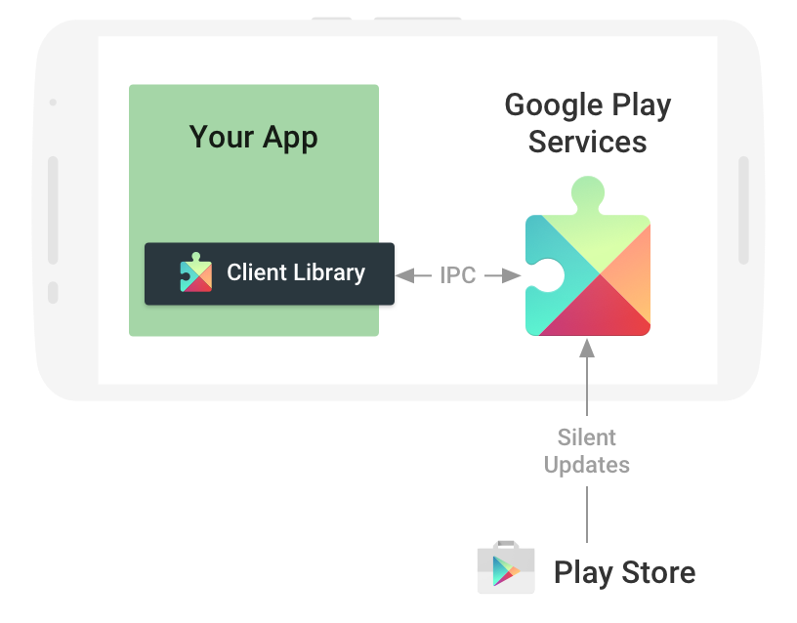
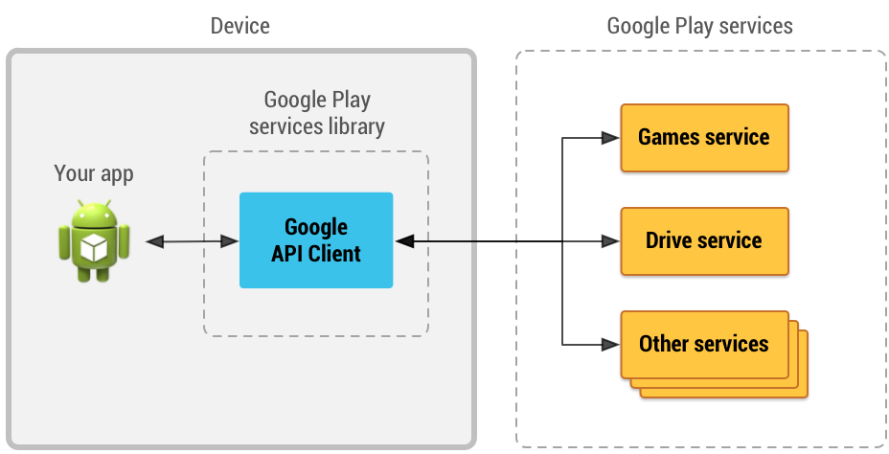
Location Tracking
Responsible for getting the user’s current location
Uses Google Play services Location APIs

Slide 21
class LocationTracker{
constructor(){
Build Google Api Client;
Set location request parameters (interval, fastest interval, priority);
Connect to Google Api Client;
}
onConnected(){
Request for location update based on location request parameters;
}
onLocationChanged(){
Remove location updates;
Disconnect from Google Api Client;
}
ifSettingsChecked(){
Checks if phone settings allow application to get location using GPS and network-based sources;
}
hasLocation(){
Checks if latitude and longitude values are set based on location retrieved from Google Api Client
}
}
Notes:
Interval – Rate at which app prefers to receive location updates.
Fastest interval – Fastest rate at which app can handle location updates. Other apps also affect rate at which updates are sent.
Priority – Sets priority of request (Balanced_Power_Accuracy, High_Accuracy, Low_Power, No_Power)
R

Slide 22

Messaging
Responsible for getting the User’s personal/medical information and emergency contact list
Sends four text messages to each contact including the user’s personal message, medical information, and location

Slide 23
class Message{
constructor(){
Set field members: latitude & longitude
}
sendMessage(){
Get user medical information from Shared Preferences;
Get contacts list from SQLite DB;
For each contact, send message containing custom message, user medical information, and location
}
{

Slide 24
Test and Evaluate application
Front | Trial
 | 1 | 2 | 3 | 4 | 5
Accident Detected | Y | Y | Y | Y | Y
Number of Contacts | 3 | 3 | 3 | 3 | 3
Messages Sent | 3 | 3 | 3 | 3 | 3
Left | Trial
 | 1 | 2 | 3 | 4 | 5
Accident Detected | Y | Y | Y | Y | Y
Number of Contacts | 3 | 3 | 3 | 3 | 3
Messages Sent | 3 | 3 | 3 | 3 | 3
Back | Trial
 | 1 | 2 | 3 | 4 | 5
Accident Detected | Y | Y | Y | Y | Y
Number of Contacts | 3 | 3 | 3 | 3 | 3
Messages Sent | 3 | 3 | 3 | 3 | 3
Right | Trial
 | 1 | 2 | 3 | 4 | 5
Accident Detected | Y | Y | Y | Y | Y
Number of Contacts | 3 | 3 | 3 | 3 | 3
Messages Sent | 3 | 3 | 3 | 3 | 3
Notes:
Objective 4

Slide 25
Sample Data
Right-orientation trial
Falling action below 0.6g
Impact spike to 3.5g
1g normalization

Slide 26
Survey Results

Slide 27
Survey Results

Slide 28
Survey Results

Slide 29
Survey Results

Slide 30
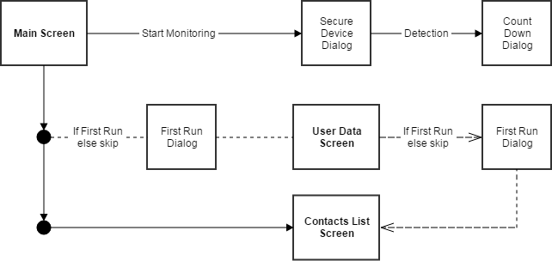
Screen Flow

Slide 31
Demonstration

Slide 32
Summary of Findings, Conclusions, and Recommendations

Slide 33
Summary of Findings, Conclusions, and Recommendations
Utilizing the Kangas et. al algorithm, smartphones are capable of detecting falls from waist height, calculating if an impact has occurred, and determining if there has been a rapid orientation change.
The Android operating system has features that are more than capable of building such an application. Programmers have access to tools that allow sensor manipulation and location tracking which aids in building a reliable smartphone application.
Notes:
SensorManager
Google Api Client
Google Play Location Services

Slide 34
Summary of Findings, Conclusions, and Recommendations (cont.)
The researchers found there was a low upper limit to the values the accelerometer can obtain, which resulted in an upper limit for the sum vector (3.464031g)
Further testing should be done to see if it is viable for detection of accidents with larger scopes, higher falls, and bigger situations. i.e. real motorcycle accidents
The researchers also found that location tracking does not require any subscription to a mobile data plan. Initially this was the assumption, however upon development and testing, the location of the application user can in fact be determined with the smartphone’s GPS capabilities or nearby cell towers without spending currency on a data plan.

Slide 35
Summary of Findings, Conclusions, and Recommendations (cont.)
Improved user interface
Multipart text messages
Background service
Connect to city Emergency Response Units
Notes:
Multipart text messages would consume the same amount of currency if they are longer than 160 characters

Slide 36
Thank you! ありがとうございます 非常謝謝

